Slide 1
Hemophilia Guidelines for All
A new ambition of the World Federation of Hemophilia

Slide 2
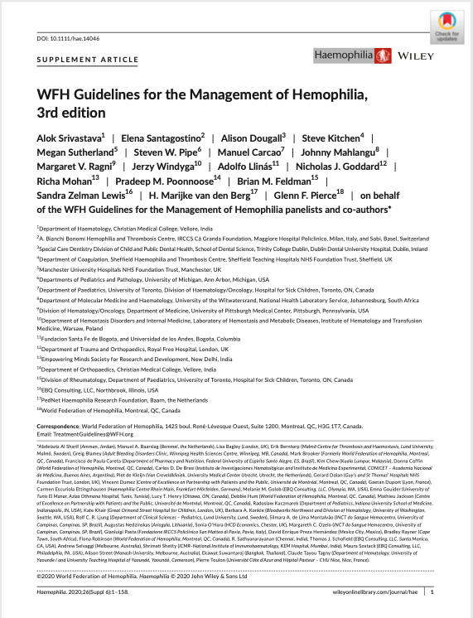
WFH Guidelines for the Management of Hemophilia
All recommendations are consensus based.
Srivastava A et al. Haemophilia. 2020;26(Suppl 6):1–158.

Slide 3
Chapter 11: Outcome Assessment
Pradeep M. Poonnoose MD
Professor, Department of Orthopaedics
Christian Medical College
Vellore, India

Slide 4
Disclosures: Pradeep M. Poonnoose
No competing interests to declare

Slide 5
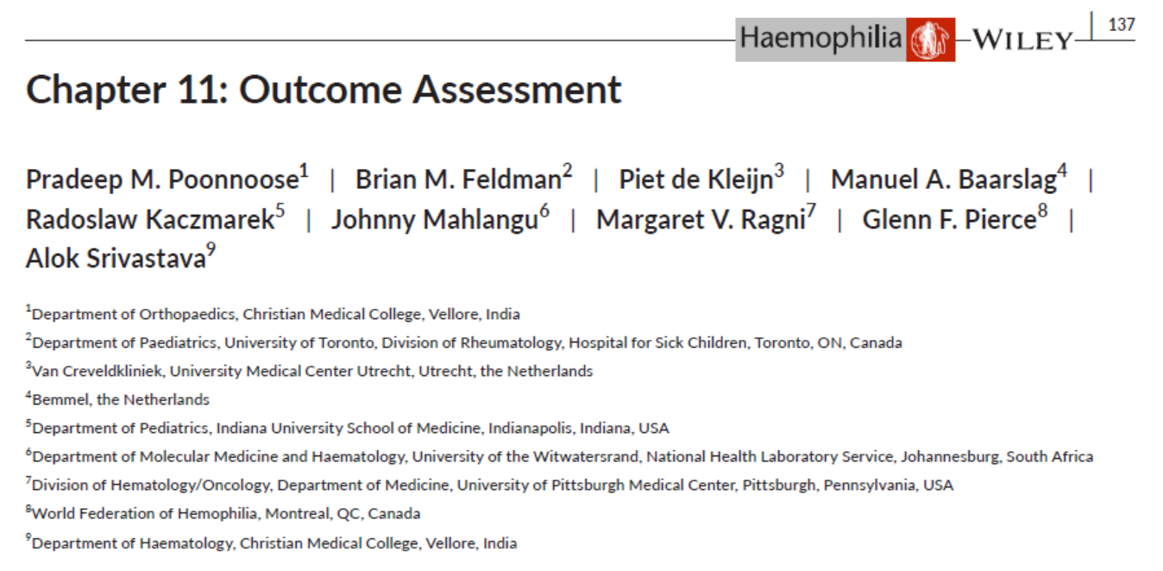
Authors
Pradeep M. Poonnoose
Brian M. Feldman
Piet de Kleijn
Manuel A. Baarslag (PWH)
Radoslaw Kaczmarek
Johnny Mahlangu
Margaret V. Ragni
Glenn F. Pierce
Alok Srivastava
PWH, person with hemophilia.

Slide 6
Introduction
Outcome refers to the condition of a patient that results from a disease or medical intervention, and is assessed by clinical evaluation, including the use of:
Generic and disease-specific health related quality of life assessment instruments
Patient-reported outcome measures
Laboratory tests
Imaging studies
Outcome assessment instruments in hemophilia measure a variety of parameters including:
Activities and participation
Body structure and function
Burden of disease
Health status

Slide 7
Outcome assessment objectives
The purposes of outcome assessment are to:
Follow an individual's disease course
Obtain information to guide routine clinical care
Measure response to therapy
Determine whether there is a need to modify therapy
Quantify the health of a group of patients
Measure quality of care
Advocate for resources

Slide 8
Outcome assessment
Two main aspects
Disease-related outcomes = effectiveness of hemostatic therapy
Therapy-related outcomes =
what needs to be monitored
Frequency of bleeding
Pain
Impact of bleeding on the musculoskeletal system
Quality of life
Inhibitor development
Thrombosis
Allergic/anaphylactic reactions

Slide 9
Outcome
Frequency of bleeding
Frequency of bleeding is the most important indicator of effectiveness of hemostatic therapy and the best surrogate predictor of long-term musculoskeletal outcomes
Joint bleed | An unusual sensation “aura” in the joint, in combination with any of the following increasing swelling or warmth of the skin over the joint; increasing pain; or progressive loss of range of motion or difficulty in using the limb as compared with baseline.
Muscle bleed | An episode of bleeding into a muscle, determined clinically and/or by imaging studies, generally associated with pain and/or swelling and loss of movement over baseline.

Slide 10
Outcome
Frequency of bleeding
Recommendation 11.2.1
For providers of care for people with hemophilia, the WFH recommends ensuring that the frequency of all bleeds is documented in real time by patients/caregivers and reviewed together at least annually, with particular reference to intra-articular, intramuscular, and central nervous system bleeds, including their recovery status. Standard criteria defined by the Scientific and Standardization Committee of the International Society on Thrombosis and Haemostasis should be used.

Slide 11
Until two decades ago, severity of joint arthropathy was assessed by:
Bleeding frequency
Clinical Score – Gilbert’s score
Radiological score – Pettersson (X-ray)
Not standardized – no validity/reliability studies
Insensitive to early change
Do not consider normal childhood variants

Slide 14
Outcome assessment instruments
ICF model
Disease Hemophilia
QoL
Body structure and function
Activity
Participation
Environmental
factors
Personal
factors
ICF, International Classification of Functioning, Disability and Health; QoL, Quality of Life.

Slide 15
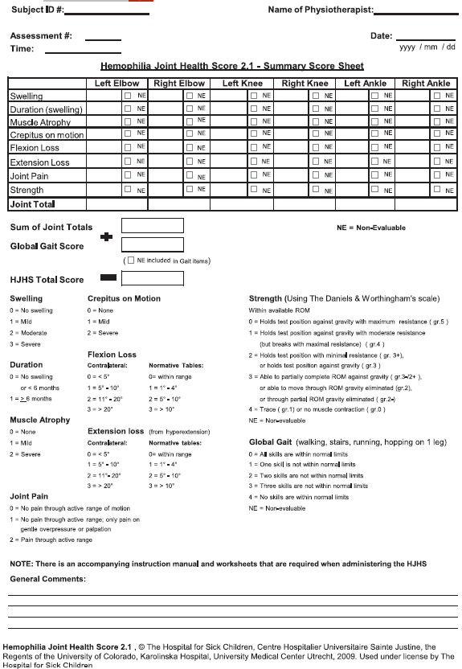
Outcome assessment instruments
Body structure and function
HJHS
The HJHS assesses:
Duration (swelling)
Swelling
Muscle Atrophy
Crepitus on motion
Flexion Loss
Extension Loss
Joint Pain
Strength
Joint Total + Global Gait Score = Total HJHS Score
HJHS, Hemophilia Joint Health Score 2.1 – Summary Score Sheet.
Available at: http://www1.wfh.org/docs/en/Publications/Assessment_Tools/HJHS_Summary_Score.pdf

Slide 16
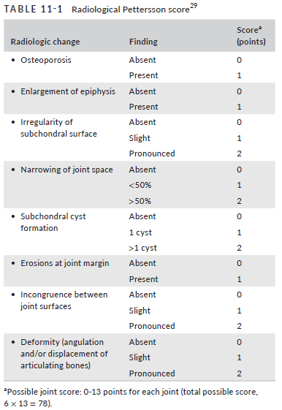
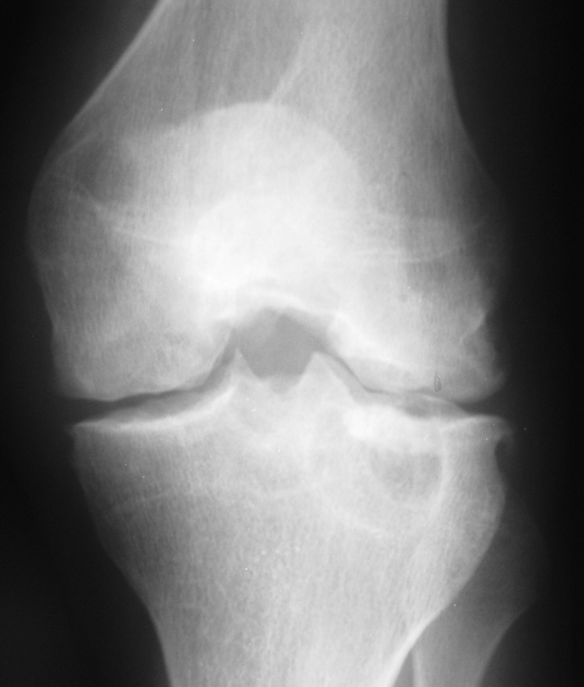
Outcome assessment instruments
Body structure and function
Pettersson score
X-Ray

Slide 17
Recommended measures
Body structure and function
In hemophilia, body structure and function refers to, for example, the status of joints and specific muscle groups, assessed both clinically and radiologically
HJHS
X-Ray
US
MRI
  The Hemophilia Joint Health Score (HJHS) is the most commonly used tool for clinical assessment of joints; used in both children and adults.
  The radiological Pettersson score is the most widely used imaging measure of joint structure. It is however not sensitive to early change.
  Ultrasound (US) imaging can detect joint effusion, early joint disease, and subclinical joint disease, and promote medication adherence.
  Magnetic resonance imaging (MRI) is likely the most sensitive measure of joint structure- but is is expensive, time consuming, and difficult to perform in small children.

Slide 18
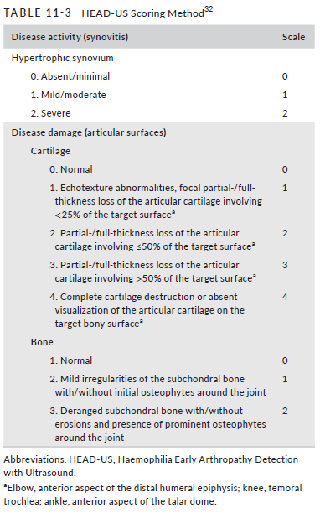
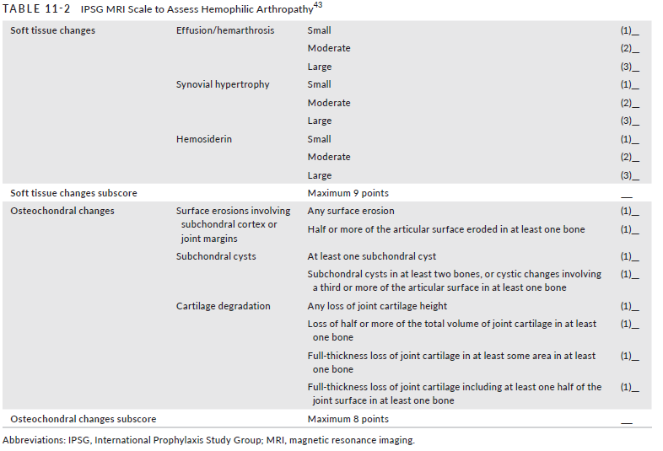
Outcome assessment instruments
Body structure and function
US
MRI
MRI, magnetic resonance imaging; US, ultrasound.

Slide 19
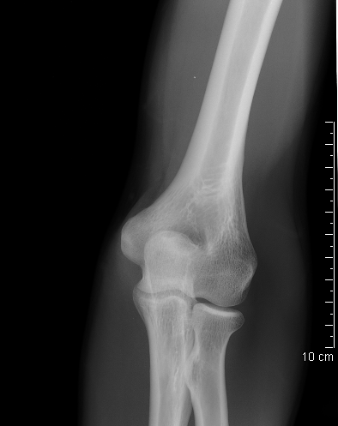
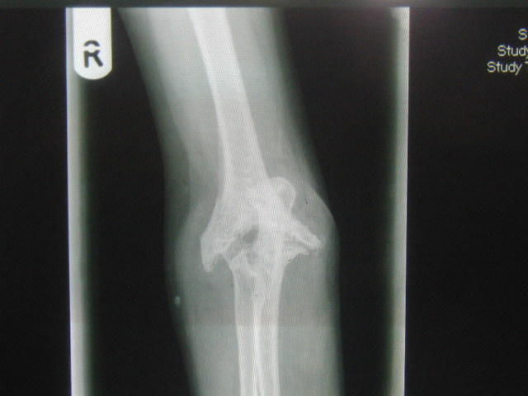

Slide 21
Outcome assessment instruments
Activity and participation scales
Disease Hemophilia
HAL / PedHAL
HJHS
FISH
HAL / PedHAL
COPM
International Classification of Functioning and Health (ICF) model, with domain-related outcome assessment instruments
X-ray
Body structure and function
Activity
Participation
SF-36
US
PROBE
MRI
HAEMO-QoL-A
Environmental
factors
Personal
factors
COPM, Canadian Occupational Performance Measure; FISH, Functional Independence Score in Hemophilia; HAEMO-QoL-A, hemophilia specific quality-of-life questionnaire for adults; HAL, Haemophilia Activities List; HJHS, Hemophilia Joint Health Score; ICF, International Classification of Functioning, Disability and Health; MRI, magnetic resonance imaging; PedHAL, Haemophilia Activities List for children; PROBE, Patient-Reported Outcomes, Burdens and Experiences; SF-36, 36-Item Short Form Survey Instrument; US, ultrasound.

Slide 22
Outcome assessment instruments
Activity and participation scales
In hemophilia, activity refers to instrumental activities of daily living (e.g., walking, climbing steps, brushing teeth, toileting)
Participation refers to involvement in life situations in the context of social interactions
HAL & PedHAL
FISH
PROBE
COPM & MACTAR
  The Haemophilia Activities List (HAL) and PedHAL are disease-specific, self reported measures of activities for adults and children, respectively.
  The Functional Independence Score in Hemophilia (FISH) is the best studied observed performance measure for people with hemophilia, used in many countries and age groups.
  The Patient-Reported Outcomes, Burdens and Experiences (PROBE) questionnaire includes metrics that assess activities and participation, such as school/education, employment, family life, and impact on activities of daily living.
  The Canadian Occupational Performance Measure (COPM) and the McMaster Toronto Patient Disability Questionnaire (MACTAR) are generic instruments used for day-to-day assessment of a person's perception of changes in their activities and participation.

Slide 23
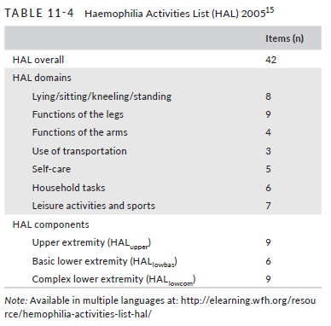
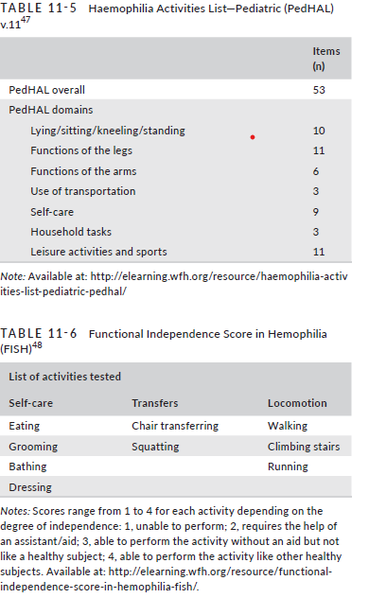
Outcome assessment instruments
Activity and participation scales
HAL & PedHAL
FISH
FISH, Functional Independence Score in Hemophilia; HAL, Haemophilia Activities List; PedHal, Haemophilia Activities List for children.

Slide 24

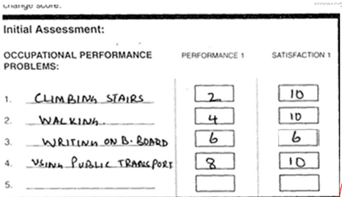
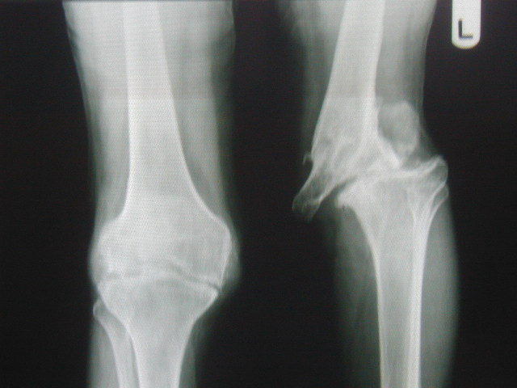
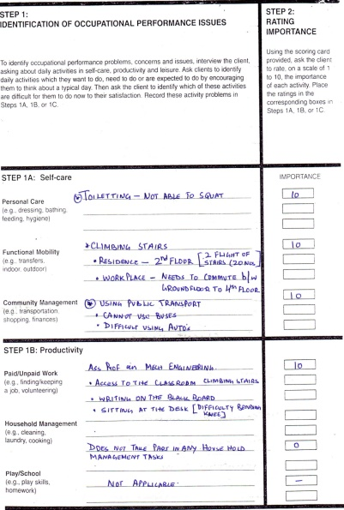
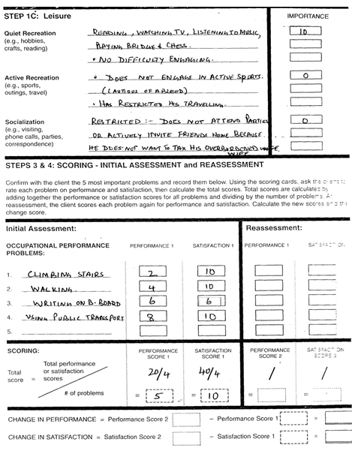
Clinical Scenario:

Slide 25
ICF Model
Environmental and personal factors
Disease Hemophilia
HAL / PedHAL
HJHS
FISH
HAL / PedHAL
COPM
International Classification of Functioning and Health (ICF) model, with domain-related outcome assessment instruments.
X-ray
Body structure and function
Activity
Participation
SF-36
US
PROBE
MRI
HAEMO-QoL-A
Environmental
factors
Personal
factors
COPM, Canadian Occupational Performance Measure; FISH, Functional Independence Score in Hemophilia; HAEMO-QoL-A, hemophilia specific quality-of-life questionnaire for adults; HAL, Haemophilia Activities List; HJHS, Hemophilia Joint Health Score; ICF, International Classification of Functioning, Disability and Health; MRI, magnetic resonance imaging; PedHAL, Haemophilia Activities List for children; PROBE, Patient-Reported Outcomes, Burdens and Experiences; SF-36, 36-Item Short Form Survey Instrument; US, ultrasound.

Slide 26
Economic factors to consider
Direct costs include the cost of medical treatments, health services, and surgical
and medical supplies. CFCs account 90% of the treatment-related cost.
Indirect costs arise from loss of work productivity of adult patients and of parents
of pediatric patients due to the time they spend managing their child's hemophilia care.
The costs that result from illness or seeking medical care are sometimes
similar but often vary by country.
CFCs, clotting factor concentrates.

Slide 27
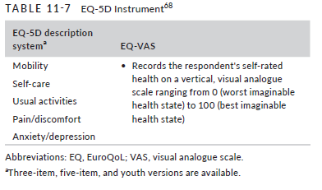
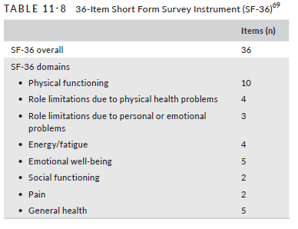
Health-related quality of life
HRQoL measurements are questionnaires that aim to quantify a patient's health in a global way, however it is best applied in combination with specific assessments of the ICF domains rather than in isolation
The EQ-5D and SF-36 are widely used generic instruments for assessing QoL in hemophilia
EQ-5D Instrument
SF-36 Instrument
EQ-5D, EuroQoL 5 Dimensions; HRQoL, health-related quality of life; ICF, International Classification of Functioning, Disability and Health; QoL, quality of life; SF-36, 36-Item Short Form Survey Instrument; VAS, visual analog scale.

Slide 28
Health-related quality of life
The PROBE, CHO-KLOT, and HAEMO-QoL-A are disease specific instruments used to assess QoL in hemophilia
PROBE
CHO-KLOT
HAEMO-QoL-A
Assesses QoL in addition to burden of disease in people with hemophilia.
For children with hemophilia, the Canadian Hemophilia
Outcomes-Kids Life Assessment Tool (CHO-KLAT) is widely used.
For adults with hemophilia, the hemophilia-specific QoL questionnaire for adults
(HAEMO-QoL-A) is widely used.
PROBE, Patient-Reported Outcomes, Burdens and Experiences; QoL, quality of life.

Slide 29
Patient-reported outcomes
PROs provide a report of the status of a patient's health condition that comes directly from the patient
It encompasses both single-dimensional and multi-dimensional measures of symptoms, HRQoL, health status, adherence to treatment, satisfaction with treatment, and other measures
HRQoL, Health-Related Quality of Life; PRO, patient reported outcome.

Slide 30
Recommendations
Recommendation 11.7.1
The WFH recommends assessing and documenting the musculoskeletal and overall health of each patient at least annually. This should include an assessment of body structure and function, activity levels, participation and health-related quality of life as per the World Health Organization's International Classification of Functioning, Disability and Health (WHO ICF), as much as possible, in the right clinical context.
REMARK: Standard definitions and validated tools should be used as much as possible, including the following:
For body structure and function, clinical assessment of joints is (most) commonly done using the Hemophilia Joint Health Score (HJHS) in both children and adolescents.
Under the same domain, early structural changes in joints are best assessed using ultrasound (US) or magnetic resonance imaging (MRI). Late osteochondral changes may be assessed on plain radiographs.
Functional activity levels should be assessed using the most appropriate option available for that individual, including the Haemophilia Activities List (HAL), the Haemophilia Activities List for children (PedHAL), or the Functional Independence Score in Hemophilia (FISH).
HRQoL is an important aspect of outcome measurement that may be assessed using either generic or disease-specific tools, but only in combination with the other domains of the WHO ICF.
HRQoL, Health-Related Quality of Life.

Slide 31
Core set of measures for use in the clinic or research setting
To extract the potential of value-based health care, standardized outcome measures must be encouraged
The WFH World Bleeding Disorders Registry (WBDR) provides a platform for hemophilia treatment centres to collect uniform and standardized patient data and outcomes globally to guide clinical practice
  http://www.wfh.org/en/our-work-research-data/world-bleeding-disorders-registry
A selection of outcome assessment instruments can be accessed at the WFH Compendium of Assessment Tools webpage
  http://elearning.wfh.org/resource/compendium-of-assessment-tools/
Notes:
To extract the potential of value-based health care, standardized outcome
measures must be encouraged.
The WFH World Bleeding Disorders Registry (WBDR) provides a platform
for hemophilia treatment centres to collect uniform and standardized patient
data and outcomes globally to guide clinical practice
(http://www.wfh.org/en/our-work-research-data/world-bleeding-disorders-registry)
A selection of outcome assessment instruments can be accessed at the WFH Compendium of Assessment Tools webpage (http://elearning.wfh.org/resource/compendium-of-assessment-tools/)

Slide 32
Conclusions
In order to optimize treatment and make economically sound clinical decisions, objective evidence of both short- and long-term outcomes of treatment regimens is required
Both generic and hemophilia-specific assessment instruments make it possible to evaluate the nature of the physical impairments and functional limitations and their impacts on the lives of people with hemophilia and their families
The increasing use of these instruments will standardize assessment and permit comparison of data between individuals and cohorts

Slide 33
Thank you to the Hemophilia Alliance for their support in developing this presentation

