Slide 1
Hemophilia Guidelines for All
A new ambition of the World Federation of Hemophilia
Notes:
The 3rd edition of the WFH treatment guidelines for the management of hemophilia are high-quality, evidence and expert informed treatment guidelines for use around the world by HCP and patients.

Slide 2
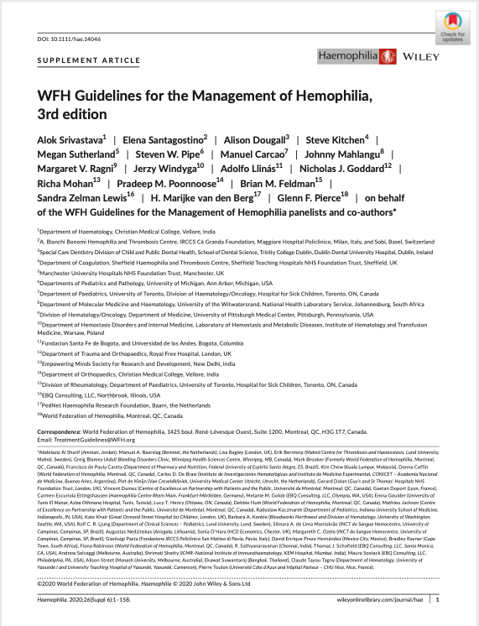
WFH Guidelines for the Management of Hemophilia
340 PRACTICE RECOMMENDATIONS
Srivastava A et al. Haemophilia. 2020;26(Suppl 6):1–158.
Notes:
Here is the reference for the published document

Slide 3
Chapter 1: Principles of care
Alok Srivastava MD, FRACP, FRCPA, FRCP
  Professor of Medicine
  Department of Hematology
  Head, Centre for Stem Cell Research
  Christian Medical College
  Tamil Nadu, India

Slide 4
Disclosures: Alok Srivastava
Grant / Research Support
Roche, Novo Nordisk, Takeda, Sanofi, Pfizer
Advisory / Grant Review Committees
Sanofi, Takeda, Novo Nordisk, Roche, Pfizer, Bayer Healthcare
Notes:
Speaker’s Notes:
Please verbalize all financial relationships to your audience

Slide 5
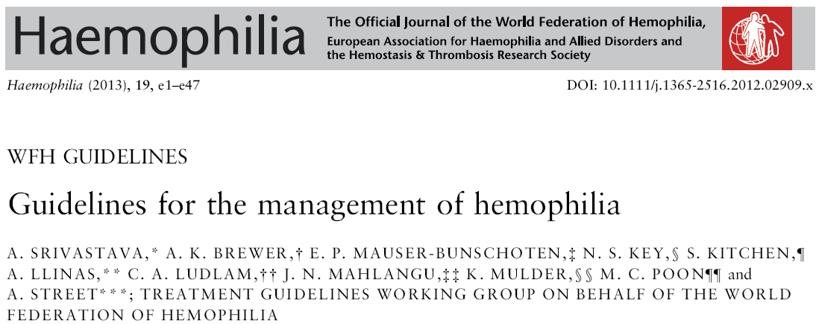
2nd edition**:
Total downloads:
>1,100,000
Total citations: 1,269
3rd edition**:
Total downloads:
>140,000
Total citations: 91
GUIDELINES FOR ALL PWH
*Endorsed by the ISTH and National Guidelines Clearinghouse, HHS, Government of USA. www.guideline.gov/content.aspx?id=39323
**As of 7th Jan 2022

Slide 6
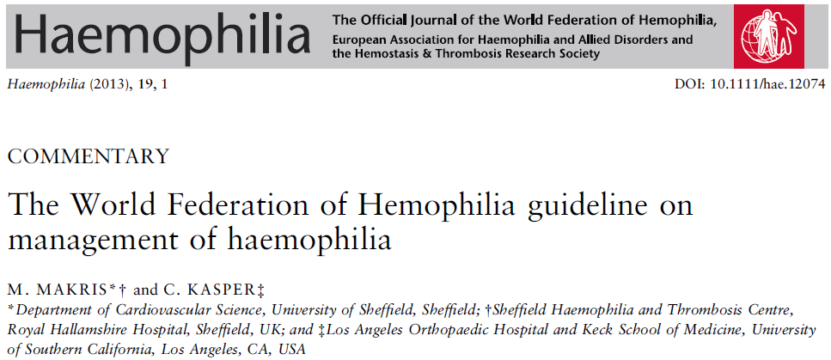
“The authors’ strong belief, however, is that the principles of management of hemophilia are the same all over the world and the differences are mainly in the doses of clotting factor concentrate used to treat or prevent bleeding. This WFH guideline is unique in addressing the issue and providing guidance for resource-rich and resource-poor countries in a single document.”

Slide 7
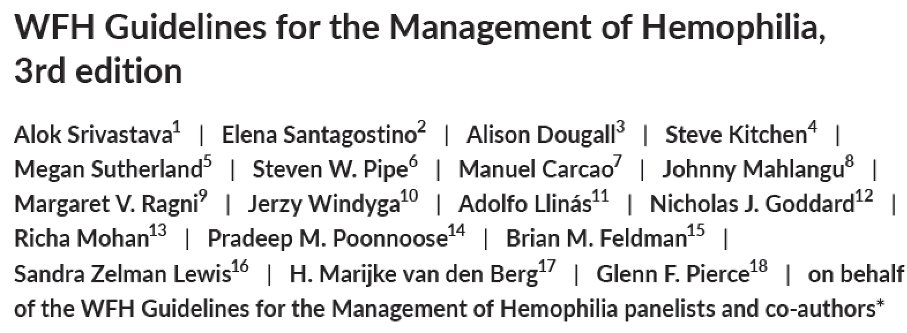
With many more HCP volunteers & PWH / caregivers, as well as professional staff from the WFH as well as external agencies
Balanced subject expert groups with PWH / families
Appointment of an independent process expert
Librarians conducted systematic literature search
Evidence tables created to share current data
Draft recommendations created based on this data
Recommendations finalized through a Delphi process
HCP, health care provider; PWH, person with hemophilia

Slide 8
WFH Guidelines for the Management of Hemophilia – Chapters (3rd edition)
Principles of care
Comprehensive care
Laboratory diagnosis and monitoring
Genetic assessment
Hemostatic agents
Prophylaxis
Treatment of specific hemorrhages
Inhibitors to clotting factors
Specific management issues
Musculoskeletal complications
Outcome assessment
Methodology
A MAJOR ENHANCEMENT FROM THE 2nd EDITION

Slide 9
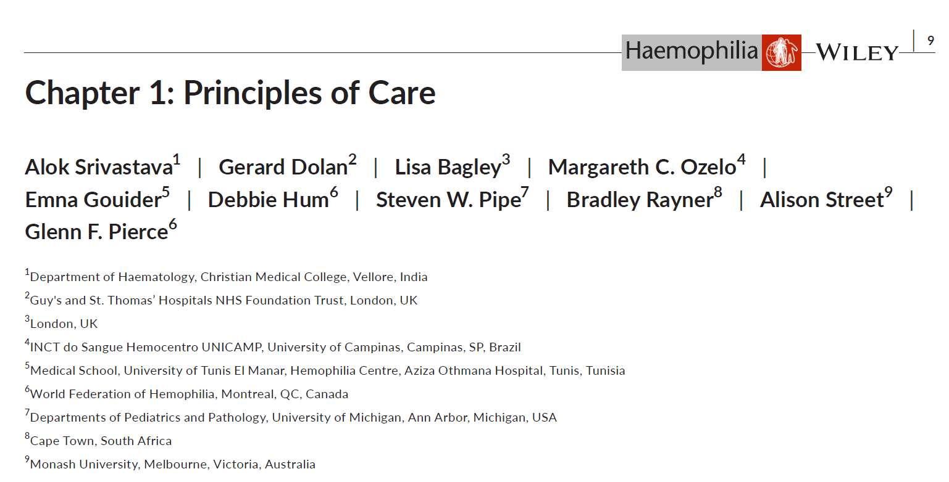
Authors
Alok Srivastava
Gerard Dolan
Lisa Bagley (PWH)
Margareth C. Ozelo
Emna Gouider
Debbie Hum
Steven W. Pipe
Bradley Rayner (PWH)
Alison Street
Glenn F. Pierce
PWH, person with hemophilia or their family
Notes:
Please say all the names of the authors

Slide 10
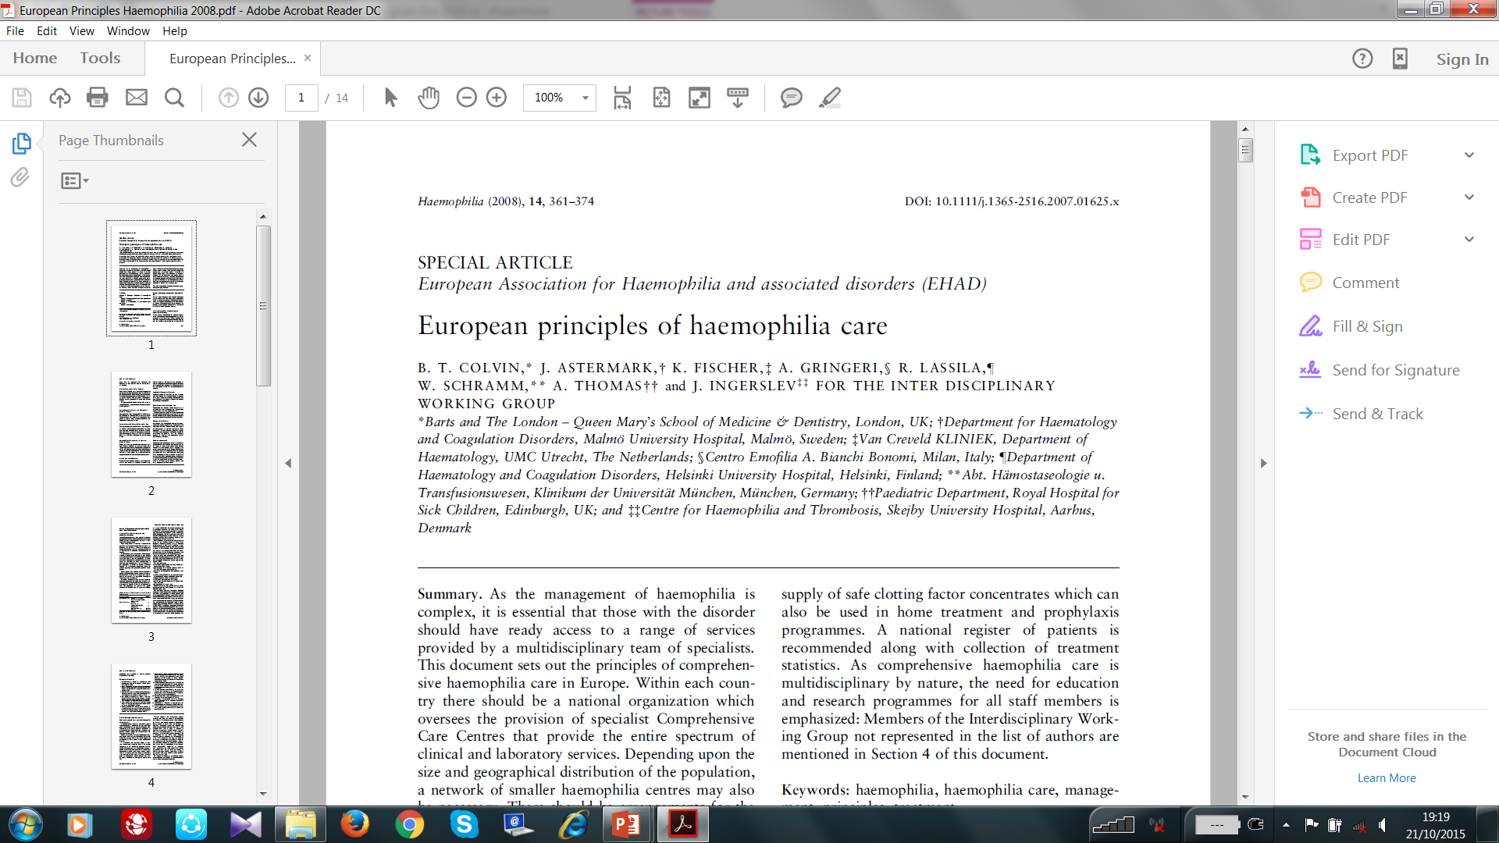
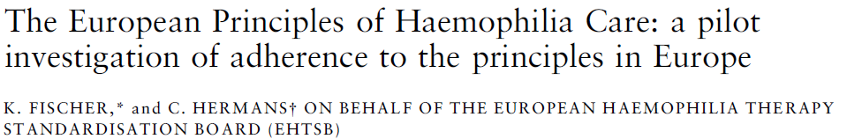
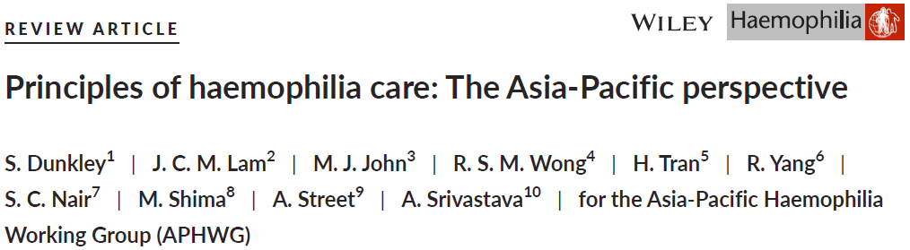
Defining the principles of care – European & Asia/Pacific
Haemophilia (2018), 24, 366-75

Slide 11
Comparing the Principles of Care – European vs Asia Pacific
 | European Principles of Hemophilia Care | Asia-Pacific Principles of Hemophilia Care
1 | A central hemophilia organisation with supporting local groups | Coordination of the delivery of hemophilia care through a national agency
2 | National hemophilia patient registries | Establish a network of hemophilia treatment centres for comprehensive care
3 | Comprehensive care centres and hemophilia treatment centres (HTCs) | Establishing and National Hemophilia Patient registry
4 | Partnership in the delivery of hemophilia care | Combined with the principle of coordination of hemophilia care (#1)
5 | Access to safe and effective concentrates at optimum treatment levels | Regular replacement therapy with CFCs
6 | Access to home treatment and delivery | Combined with the principle of CFC replacement (#5)
7 | Access to prophylaxis (preventative) treatment | Combined with the principle of CFC replacement (#5)
8 | Access to specialist services and emergency care | Emergency care and management of comorbidities
9 | Management of inhibitors | Management of Hemophilia with inhibitors
10 | Education and research | Education, training and relevant research for improving care of PWH and other bleeding disorders
11 |  | Enhance facilities for laboratory diagnosis of Bleeding disorders
12 |  | Genetic diagnosis of hereditary bleeding disorders
13 |  | Musculoskeletal Management and assessment of outcomes
14 |  | Innovative therapies and cure of hemophilia
15 |  | Recognition of socio-economic and cultural diversities of the region in planning Hemophilia care
CFC, clotting factor concentrates; PWH, people with hemophilia

Slide 12
Chapter 1: Principles of care
Provides the principles of the organization of care as well as the essential components for delivery of care
National coordination and delivery of hemophilia care
Access to safe CFCs, other hemostasis products & curative therapies
Laboratory services and genetic diagnosis of hemophilia
Education and training in hemophilia care
Clinical and epidemiological research
Acute and emergency care for bleeds
Multidisciplinary care for hemophilia
Regular replacement therapy (Prophylaxis)
Management of patients with inhibitors
Management of musculoskeletal complications
Management of specific conditions and comorbidities
Outcome assessment
These principles of care include core concepts, requirements, and priorities in the delivery and management of hemophilia care, which together constitute a framework for implementing and advancing hemophilia treatment programs.
CFC, clotting factor concentrate.

Slide 13
Principle 1 – National coordination & delivery of care
Key components for optimal hemophilia care:
Comprehensive hemophilia care - Multidisciplinary team of specialists
National or regional network of treatment centers – HCCCs & HTCs: Hub & Spoke model
National registry of patients with hemophilia
Robust processes for procurement & distribution of therapeutic products – clotting factor concentrates (CFCs) and other hemostasis products
Equitable access to services and therapeutic products
Recognition of the socioeconomic and cultural diversities
HCCC, Hemophilia Comprehensive Care Centre; HTC, Hemophilia Treatment Centre.

Slide 14
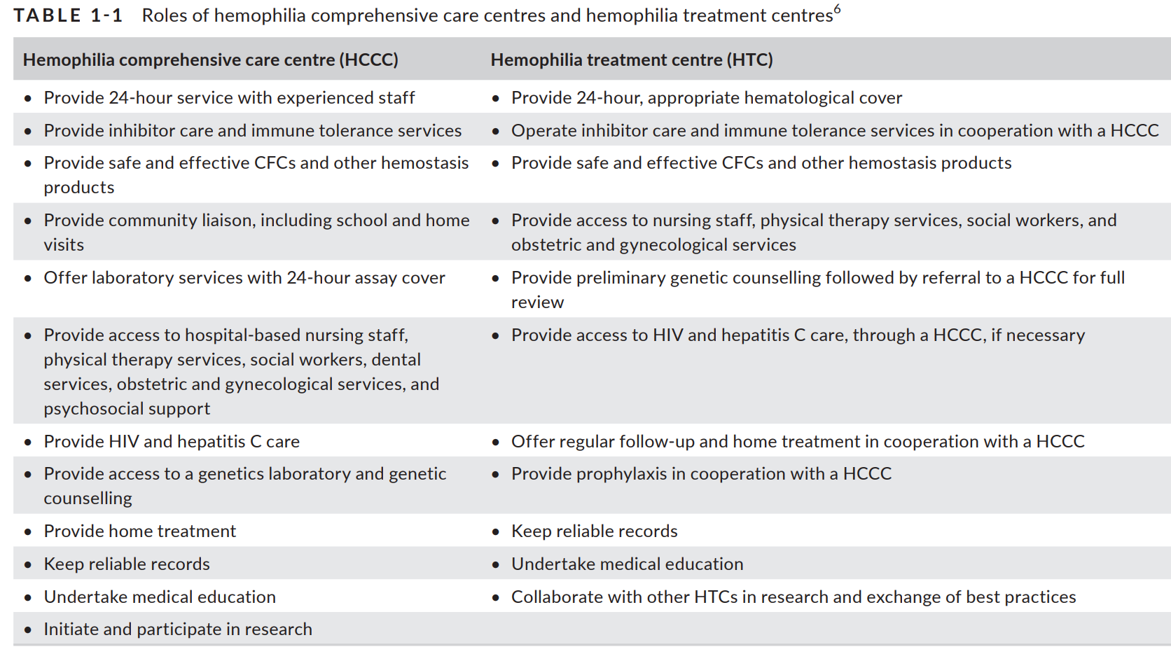
USEFUL FOR CLINICAL GUIDANCE & ADVOCACY

Slide 15
Principle 2 - Access to hemostasis products
Access to safe and effective products for prevention & treatment of bleeding - pd & rCFC + alternative coagulation products - Robust system for tender and selection of products
WFH Guide for the Assessment of Clotting Factor Concentrates should be carefully reviewed
WFH Online Registry of Clotting Factor Concentrates
Prophylaxis is the standard of care for people with severe hemophilia
Episodic CFC replacement should not be considered a long-term treatment
Newer hemostasis agents have transformed the paradigm of management of hemophilia
pd, plasma derived; rCFC, recombinant clotting factor concentrates

Slide 16
Principle 3 - Laboratory diagnosis & genetic assessment
A laboratory with suitable equipment and reagents
  Capable of performing screening and confirmatory tests (Factor assay)
  Essential for diagnosis and treatment
Tests for inhibitors – Screening and Assay
Trained personnel a major challenge
Quality assurance – Internal quality control / External quality assessment
Genetic assessment of hemophilia – Increasingly used in clinical management
Principles and methods – Linkage analysis / Mutation detection / Gene sequencing
Interpretation of results – Assigning significance to variants
Genetic counseling
Special significance in countries with low detection rates

Slide 17
Under-diagnosis of hemophilia / VWD Total population & number detected
Country | Population | People with hemophilia | Approx. % of Total Expected | People with VWD
Bangladesh | 161,356,039 | 1,675 | ~10% | 2
Brazil | 209,469,333 | 12,653 | ~60% | 8,957
Canada | 37,058,856 | 3,687 | ~99% | 4,321
China | 1,392,730,000 | 18,712 | 14% | 149
Egypt | 98,423,595 | 6,028 | 61% | 583
Ethiopia | 109,224,599 | 328 | 3% | Not Known
France | 66,987,244 | 7,944 | 118% | 2,479
India | 1,352,617,328 | 20,778 | 15% | 676
Indonesia | 267,663,435 | 2,345 | 9% | 17
Japan | 126,529,100 | 6,457 | 51% | 1,325
Nigeria | 195,874,740 | 397 | 2% | 1
Pakistan | 212,215,030 | 1,982 | 9% | 294
Russia | 144,478, 050 | 7,451 | 51% | 1,950
United Kingdom | 66,488,991 | 8,348 | 125% | 10,969
United States | 327,167,434 | 17,757 | 54% | 11,805
LMIC with 1-10% PWH
LMIC with 10-60% PWH
HIC with 50-60% PWH
HIC with 100-125% PWH
Multifactorial basis for lower numbers
At the current rate of diagnosis, even in the next 50 years,
all clinically significant inherited bleeding disorders will not be identified
Data from WFH AGS 2018

Slide 18
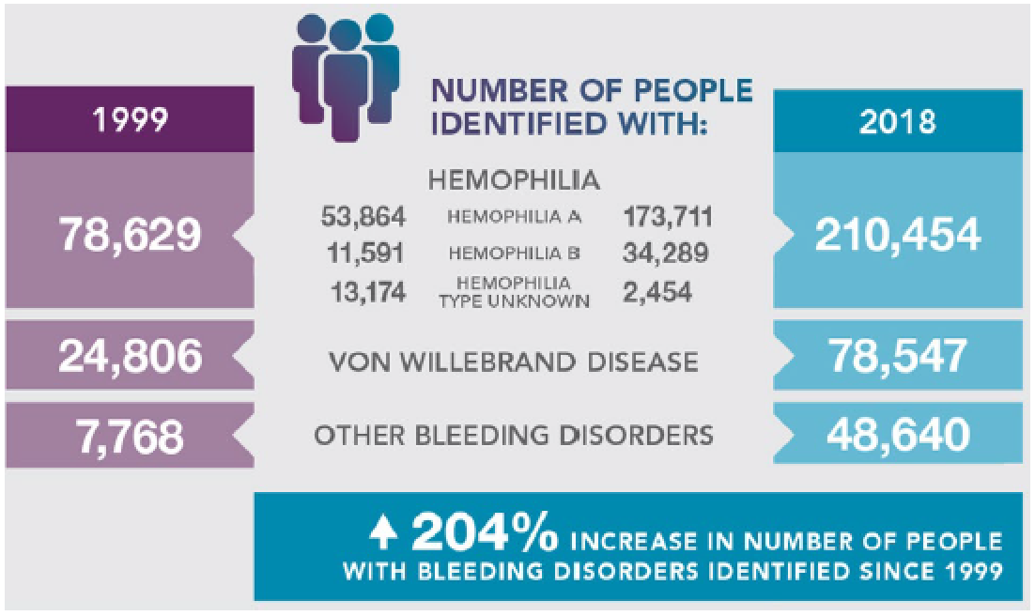
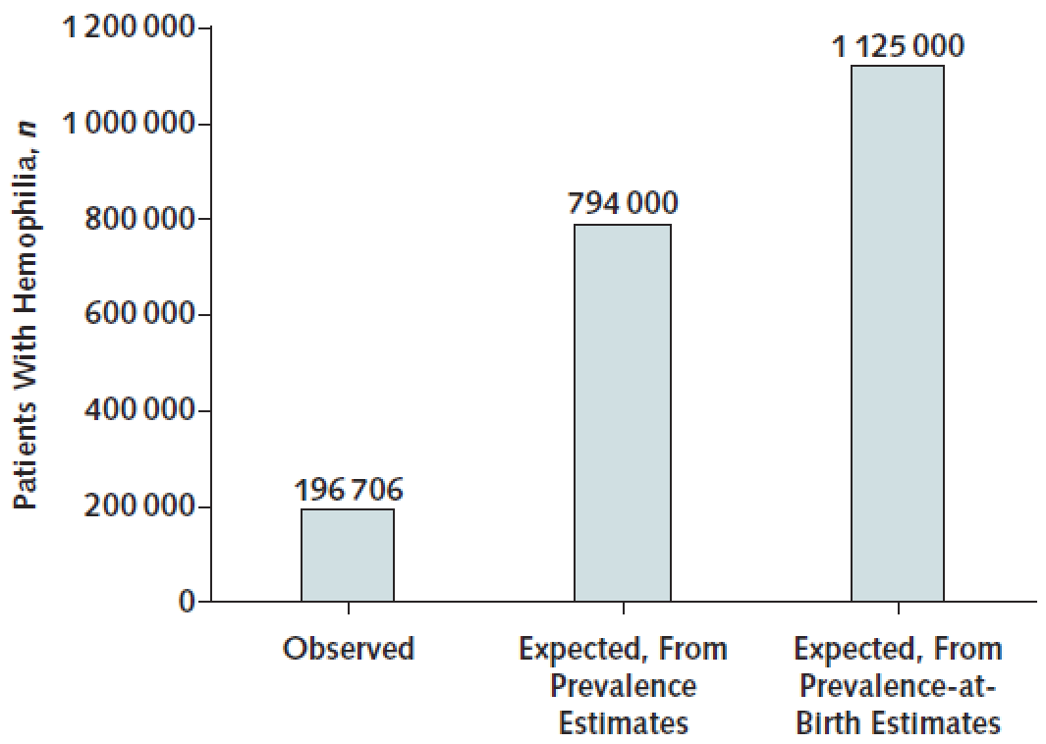
Under-diagnosis of hemophilia & allied disorders
Global identification rates:
1999: 12% → 2018: 26%
@ prevalence for hemophilia of 21 per 100 000 males
National patient registries data in Australia, Canada, France, Italy, New Zealand, and United Kingdom) show a prevalence of 25-30/100,000 male births
With a higher prevalence, the extent of under diagnosis will be even higher
Stonebraker et al Haemophilia, 2020
Ann Intern Med. 2019;171:540-546.

Slide 19
Principles 4 – Education & training
Training of a multidisciplinary team
Hemophilia care is specialized and needs multidisciplinary training
Comprehensive care
Laboratory diagnosis
Musculoskeletal management
WFH training programs
International Hemophilia Training Centers
Twinning Programs
Workshops
Webinars
Other organizations promoting training
Regional / National Hemophilia Organizations
Physicians
Pathologist
Nurse
Physio / Occupational-therapist
People with
hemophilia
Geneticist
Orthopedics
Social worker
Infectious disease
Haemophilia. 2020; Suppl 6:1–158

Slide 20
Principle 5 – Clinical & epidemiological research
Unresolved Issues in Hemophilia Care
Lack of strong evidence for many aspects for current practices
Challenges have existed in conducting appropriate studies
Priority areas of research – Local relevance
Optimal factor replacement therapy (prophylaxis) protocols
Use of alternate coagulation products
Management of acute joint bleed
Outcome assessment – Bleeding rates / MSK outcome
Registry based studies – World Bleeding Disorders Registry
Innovative therapies – Gene Therapy / Others
MSK, musculoskeletal.
Haemophilia. 2020; Suppl 6:1–158

Slide 21
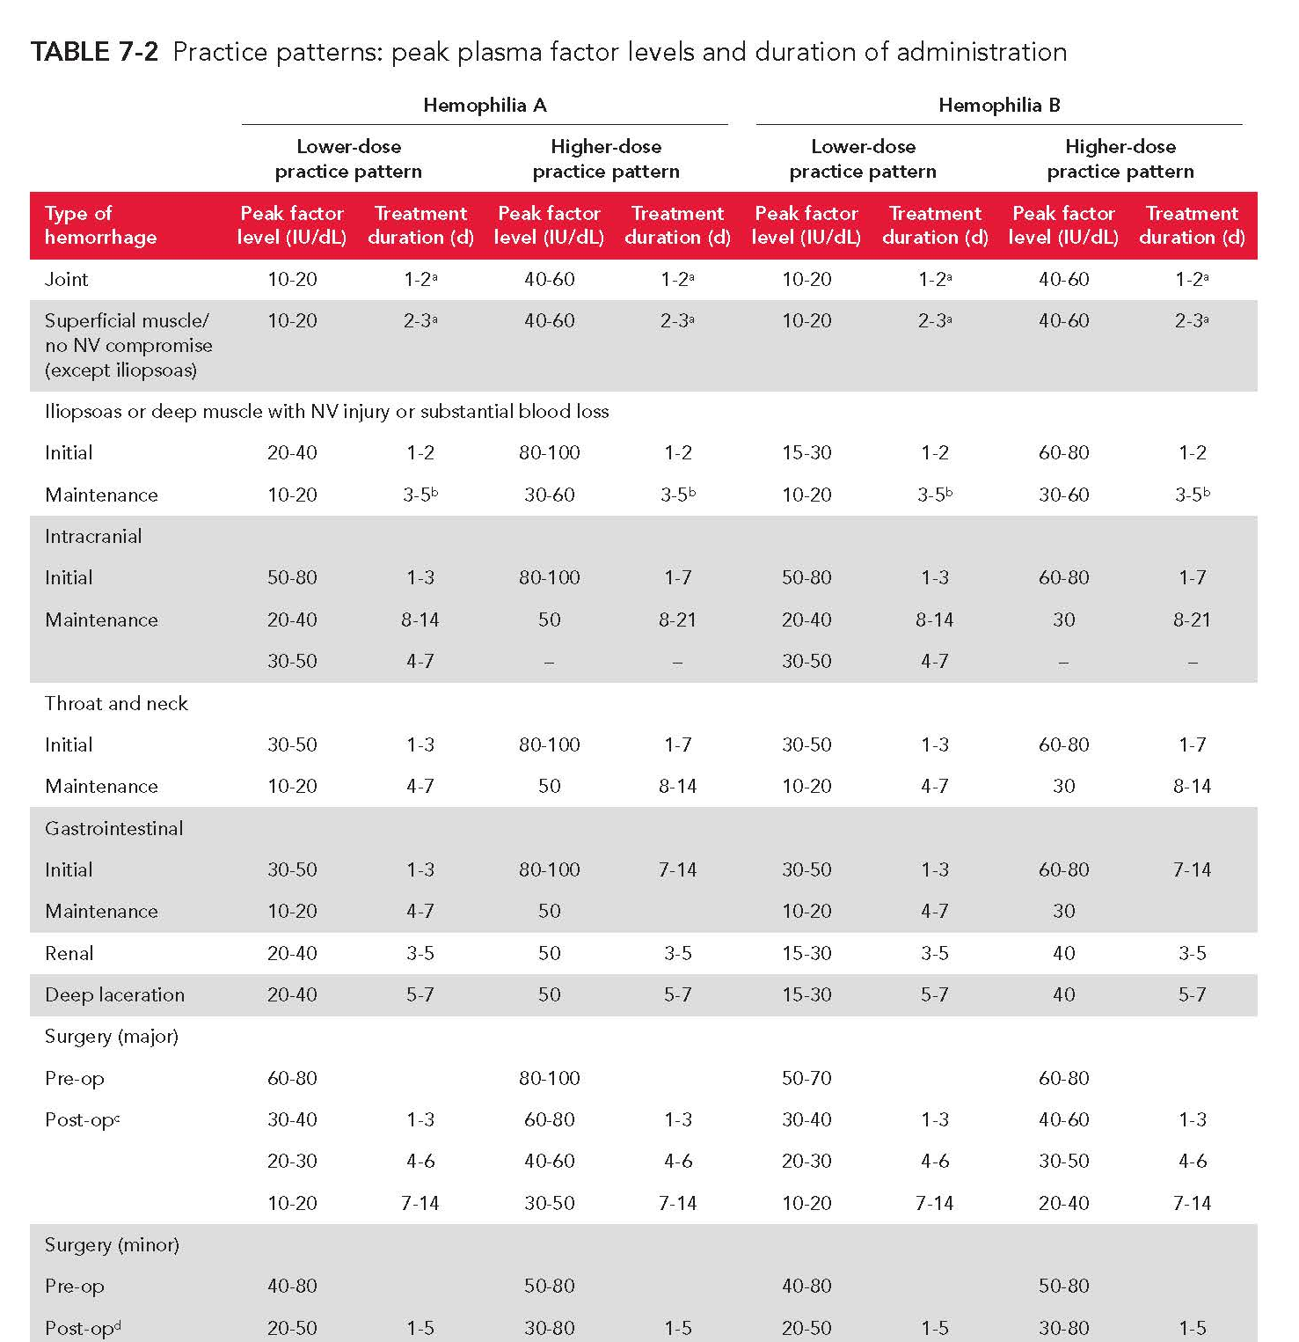
Principle 6 - Acute & emergency care of bleeding
The desired peak factor levels of CFC replacement shown for treatment of hemorrhages at different anatomical sites represent the ranges in global practice patterns depending on available resources.
Importantly, it should be recognized that the goal of such treatment is effective control of bleeding and should be the same everywhere in the world.
CFC, clotting factor concentrate.

Slide 22
Principle 7 - Multidisciplinary comprehensive care
Physician / Hematologist
Prevention of bleeding – Joint damage
Prompt treatment of bleeds
Emergency care
Pain management
Musculoskeletal management
Management of comorbidities
Psycho-social support
Transition from pediatric → adult care
Patient empowerment & self-management
  Bleed recognition & self-infusion
  Pain management
  Record keeping & reporting
  Advocacy and enhancement of care
Pathologist
Nurse
Physio / Occupational-therapists
People with
hemophilia
Geneticist
Orthopedics / Other surgeons
Social worker
Infectious disease / Hepatologist

Slide 23
Principle 8 - Regular replacement therapy: Prophylaxis
Prophylaxis – Regular replacement therapy is standard of care
  Protocols – based on half-life [t ½] of product
  SHL/EHL/Alternative Coagulation Products
  Individualized prophylaxis – Clinical / pharmacokinetic based
  ‘Lower’ dose prophylaxis – when and why?
Training / Education for home prophylaxis
HCPs also need to be familiarised with prophylaxis
The standard of care for all patients with severe hemophilia is regular replacement therapy (prophylaxis) with CFCs, or other hemostasis products to prevent bleeding, started early in life (before age 3)
Episodic (“on demand”) clotting factor replacement therapy should
no longer be considered to be a long-term treatment option.
CFC, clotting factor concentrates; EHL, extended half life; HCP, health care provider; SHL, standard half life.

Slide 24
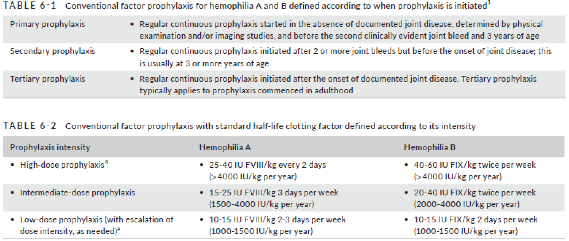
Regular replacement therapy: Prophylaxis

Slide 25
Goal of treatment for hemophilia – The future
Severe (0-1%)
Mild (5-50%)
Normal Range (50-150%)
Moderate (1-5%)
Maintaining >1% factor is certainly not the target in 2021 and beyond!
More like 3-15% factor level → to achieve a moderate / mild phenotype
To be moderate, mild or normal
Increased bleed protection (e.g. ‘zero’ ABR / AJBR)
Reduced treatment burden (e.g. less frequent dosing)
Aiming for a “normal” life with widely accessible products
ABR, annual bleeding rate; AJBR, annual joint bleeding rate.

Slide 26
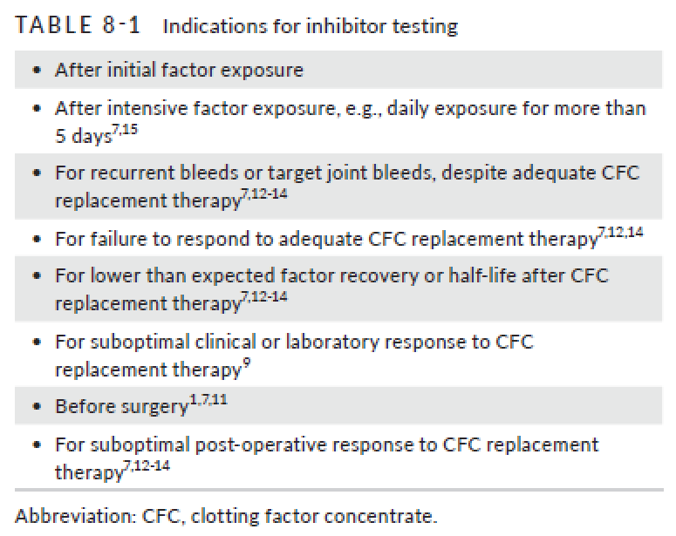
Principle 9 – Management of inhibitors to clotting factors
Factor inhibitors – Neutralizing antibodies
Systematic regular evaluation – screening / Bethesda assay
Hemophilia A – 20-30% incidence
Hemophilia B – 3-10% incidence
Management of bleeding – Bypass agents
Immune tolerance induction - ?Regimen
Management of surgical hemostasis
Newer therapies
  Emicizumab / Other Products in trials

Slide 27
Principle 10 - Management of musculoskeletal complications
Synovitis / chronic synovitis
Hemophilic arthropathy
Muscle hemorrhage
Pseudotumours
Fractures
Orthopedic surgery – Joint replacement
Surgical management
Post-op physical therapy / rehab
Complications
Orthopaedics / Rheumatology / Physiatry
Physiotherapist
Occupational therapist
Orthotics
Surgical team (with lab support)
Psycho-social support
*Strong focus on managing ‘legacy’ complications
*Till early prophylaxis becomes widely available

Slide 28
Principle 11 - Management of other conditions & co-morbidities
Management of carriers
Vaccination
Circumcision
Surgery / invasive procedures
Sexuality
Psychosocial issues
Management of co-morbidities
Medical issues with aging
Wide variations around the world – Healthcare systems / Societal expectations

Slide 29
Principle 12 – Outcome assessment - Hemostasis
Bleeding (in hemophilia):
Joint bleed - ~90% (Subjective reporting - PWH)
Other bleeds - ~10% (Can be more objective)
“Annualized Rates”:
Annual bleeding rate
→Number of bleeds - measured for 12 months
vs
Annualized bleeding rate
→Number of bleeds - extrapolated to 12 months
Joint Bleed: An unusual sensation ‘aura’ in the joint, in combination with any of the following:
increasing swelling or warmth of the skin over the joint;
increasing pain or
progressive loss of range of motion or difficulty in using the limb as compared with baseline - specially in young children
*All HCPs / PATIENTS must understand these limitations
*Ultrasound while useful has many limitations
*More research needed – to define a ‘gold’ standard
HCP, health care provider; PWH, person with hemophilia.
Haemophilia 2015; 21:731–735
J Thromb Haemost 2014; 12:1935-9

Slide 30
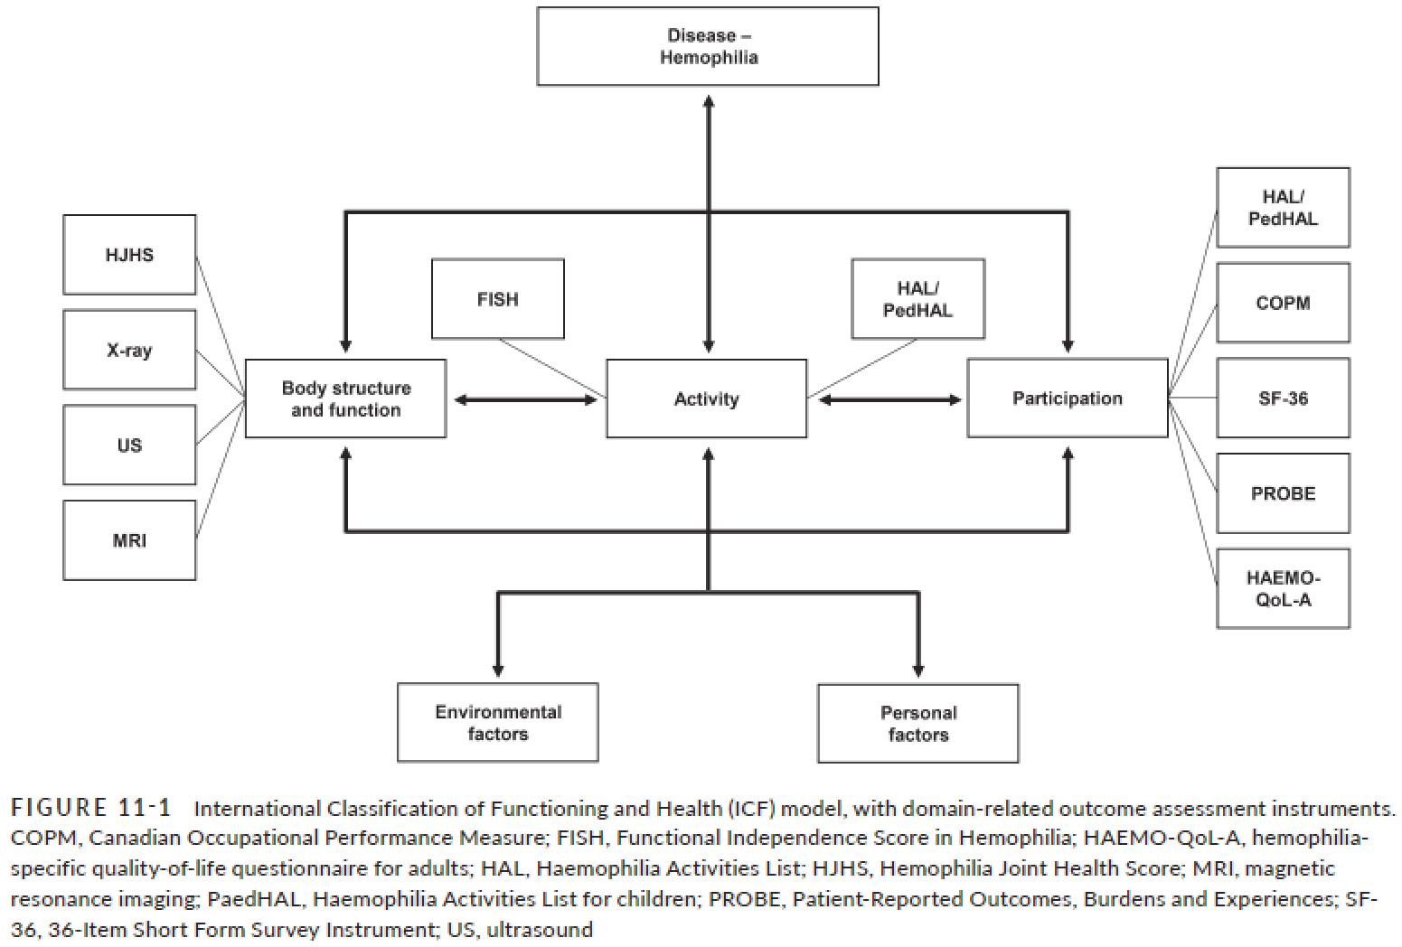
Outcome assessment - Musculoskeletal

Slide 31
Acknowledgements (1)
Health Care Professional Panelists
Erik Berntorp
Greig Blamey
Carlos D. De Brasi
Piet de Kleijn
Silmara A. de Lima Montalvão
Gerard Dolan
Alison Dougall
Carmen Escuriola Ettingshausen
Brian M. Feldman
Nicholas J. Goddard
Emna Gouider
Kate Khair
Barbara A. Konkle
Rolf C. R. Ljung
Richa Mohan
Margareth C. Ozelo
Gianluigi Pasta
PWH / Parents of PWH Panelists
Abdelaziz Khaled Al Sharif
Manuel A. Baarslag
Lisa Bagley
Francisco de Paula Careta
Kim Chew
Gaetan Duport
Mathieu Jackson
Radoslaw Kaczmarek
Augustas Nedzinskas
Enrique David Preza Hernández
Bradley Rayner
R. Sathyanarayanan
Andrew Selvaggi
Ekawat Suwantaroj
Thank you

Slide 32
Acknowledgements (2)
PROJECT TEAM
Project director: Donna Coffin
Methodology consultant: Sandra Zelman Lewis
Project manager: Melanie M. Golob
Literature manager: Lucy T. Henry
Patient partner facilitator: Mathieu Jackson
Medical librarians: Maura Sostack, Heidi Tibollo, Aleksandra Florek
Literature screeners: Sonia O'Hara, Rebecca Bungay, Chantelle Garritty, Bianca Lallitto, Denisse Mendoza, Ellia Tootoonchian, Sophie Yoon
Methodologists and data analysts: Thomas J. Schofield, Oluwaseun Akinyede, Zuleika Aponte, Saranya Chandurdu, Rodin El- Hachache, Michael Friend, Brandon Kerr, Sharath Krishna, Jane Lam, Denisse Mendoza, Erin Murray, Sheena Patel, Amy Shim, Ambrish Singh, Tracy Slanger, Sophie Yoon
Medical editors: Debbie Hum, Ellen Klaschka Espiau, Georghia Michael, David Page
GUIDELINES PROCESS TASK FORCE: Vincent Dumez, Magdy El Ekiaby, Kate Meier, Glenn F. Pierce, Thomas Sannié, Deon York
REVIEWERS
WFH Executive Reviewers: Alain Baumann, Glenn F. Pierce, Alok Srivastava, Alain Weill
External Reviewers: Victor S. Blanchette (reviewed full document), Jan Astermark, Miguel A. Escobar, Gili Kenet, Michael Makris, Pier M. Mannucci, Ingrid Pabinger-Fasching, Kathelijne Peerlinck, Rajiv K. Pruthi, Doris V. Quon, Leonard A. Valentino, Christopher E. Walsh

Slide 33
Thank you to the Hemophilia Alliance for their support in developing this presentation

